Slide 1

Introduction to Object Oriented Programming Paradigm
Instructor : Rajat Rai
Problem Solving with Java – May 2022

Slide 2
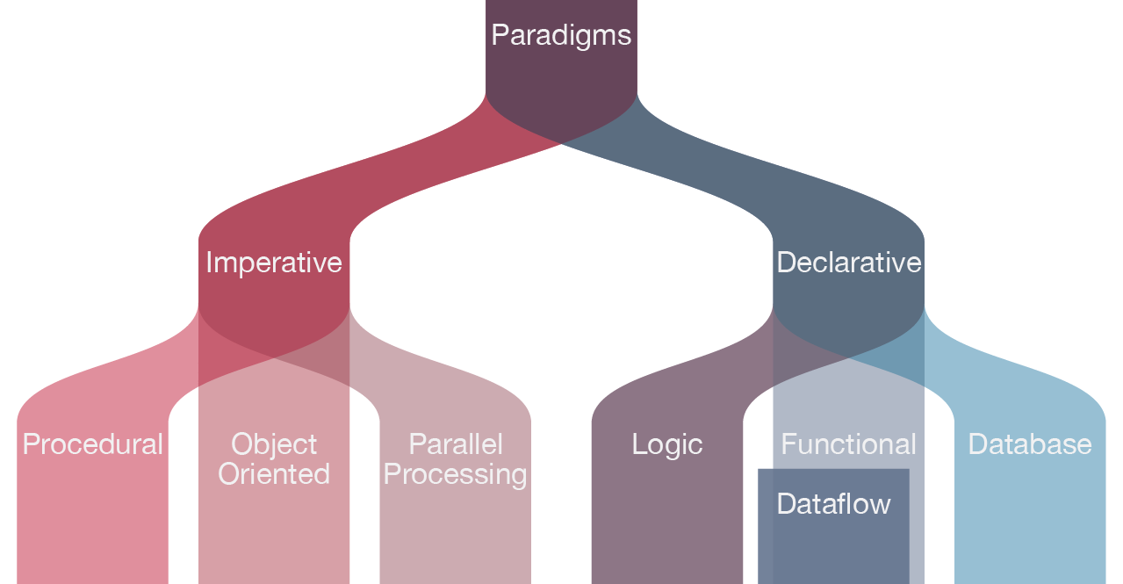
There are many languages and so are the programming paradigms.
Paradigm can also be termed as method to solve some problem or do some task.
Imperative programming focuses on HOW to execute program logic and defines control flow as statements that change a program state.
Declarative programming focuses on WHAT to execute and defines program logic, but not a detailed control flow.
This is what Java is !

Slide 3
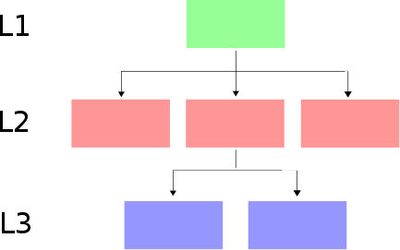
Procedural at glance
This paradigm uses a linear top-down approach and treats data and procedures as two different entities.
Simply put, Procedural Programming involves writing down a list of instructions to tell the computer what it should do step-by-step to finish the task at hand.

Slide 4
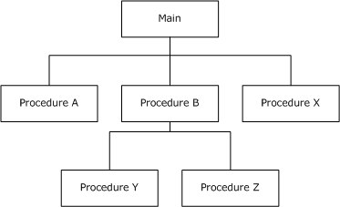

Slide 5
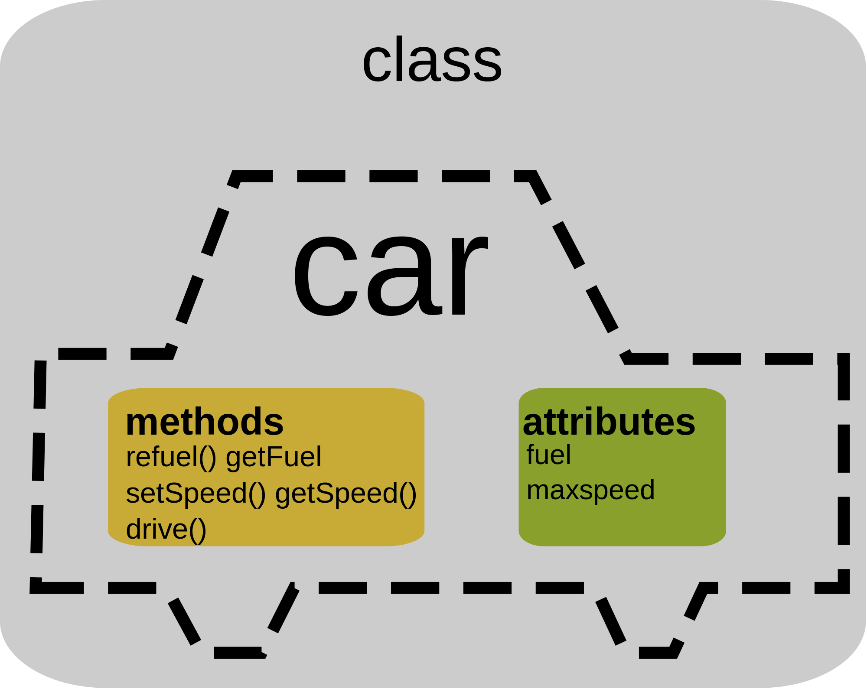


Object-Oriented Programming
It is all about objects, from object I mean the real life entity. Any entity that has state and behavior is known as an object.

Slide 6
A clear meaning
Any entity that has state and behavior is known as an object. For example, a chair, pen, table, keyboard, bike, etc. It can be physical or logical.
An Object can be defined as an instance of a class.
Collection of objects is called class. It is a logical entity.
A class can also be defined as a blueprint from which you can create an individual object.

Slide 7
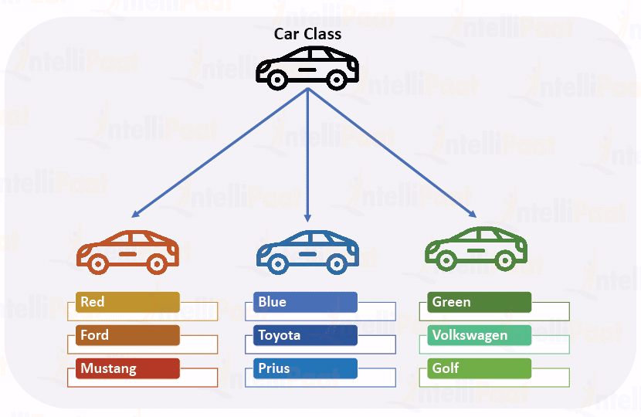

Slide 8
